Slide 1
Welcome to the “Money” task!
Press <spacebar> when you are ready to see the next instruction screen

Slide 2
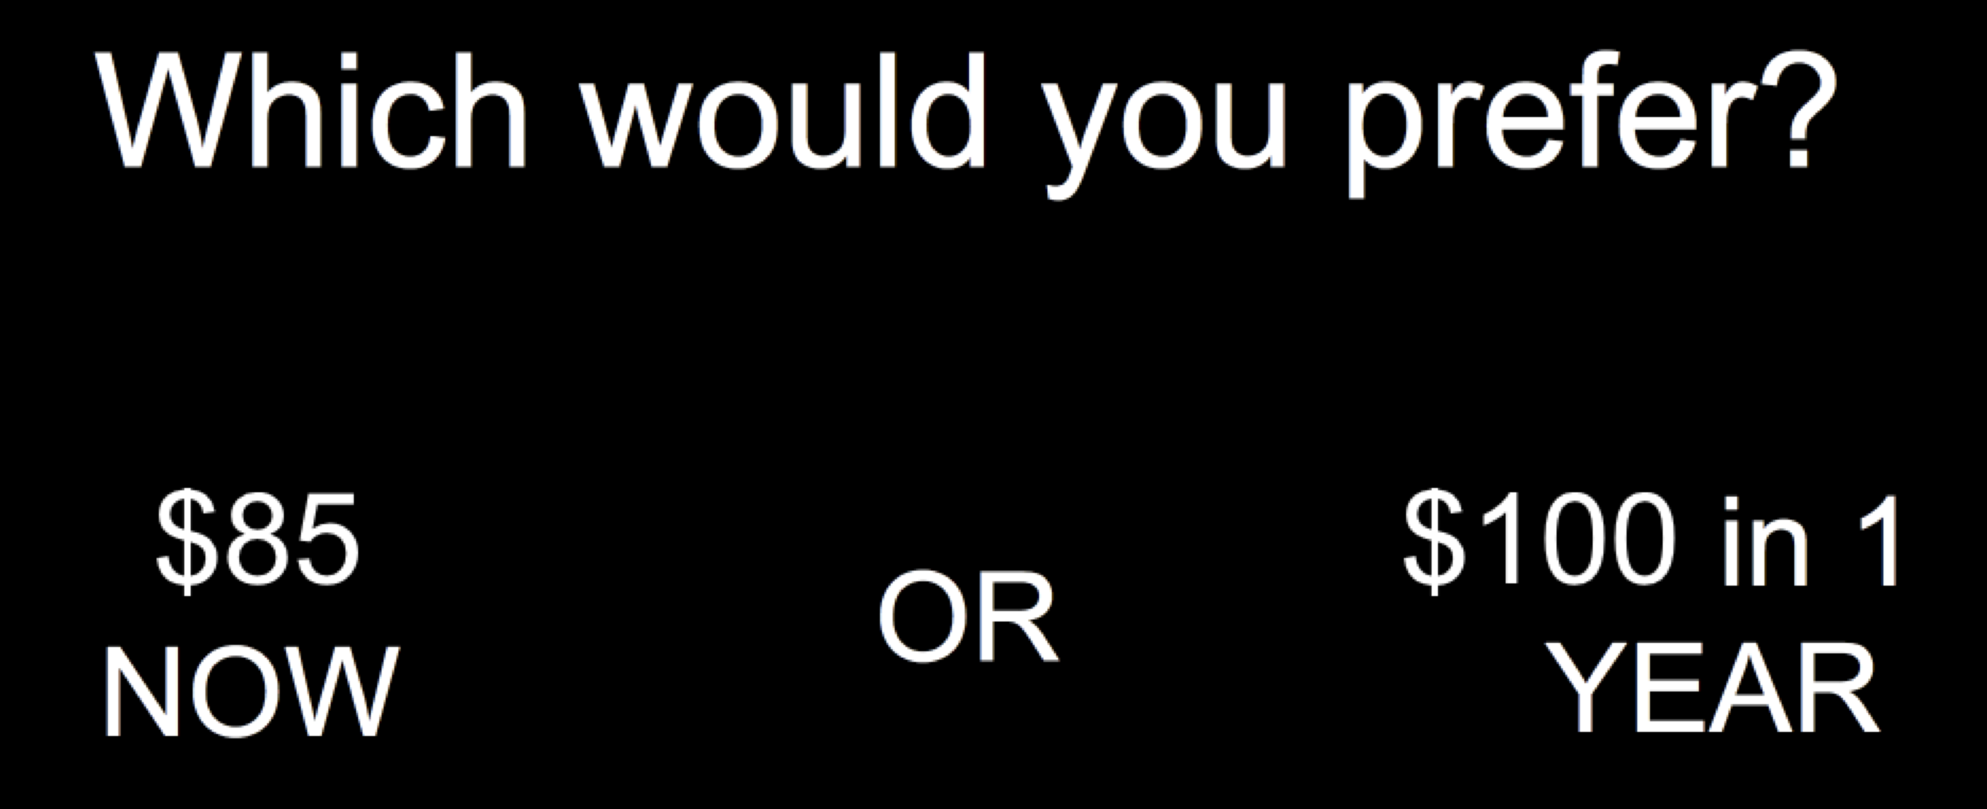
On every trial, you will be given an option between two hypothetical cash rewards and you will decide which option you would prefer. For example:
If you’d prefer the immediate reward (“$85 NOW”), press the <v> key as quickly as possible.
If you’d prefer the delayed reward (“$100 in 1 YEAR”), press the <b> key as quickly as possible.
Responses should be made using the index (‘v’) and middle (‘b’) fingers of your right hand.
Press <spacebar> when you are ready to see the next instruction screen

Slide 3
Remember that the rewards are hypothetical, you will not receive any of the rewards you choose. Simply imagine what you would choose if you were given these options in real life.
This task will consist of a maximum of 100 total trials.
Press <spacebar> when you are ready to start the task

